Slide 1

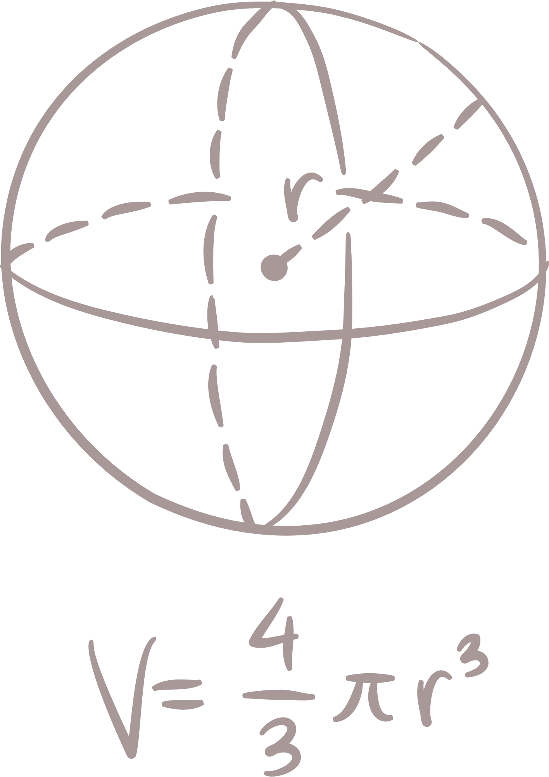

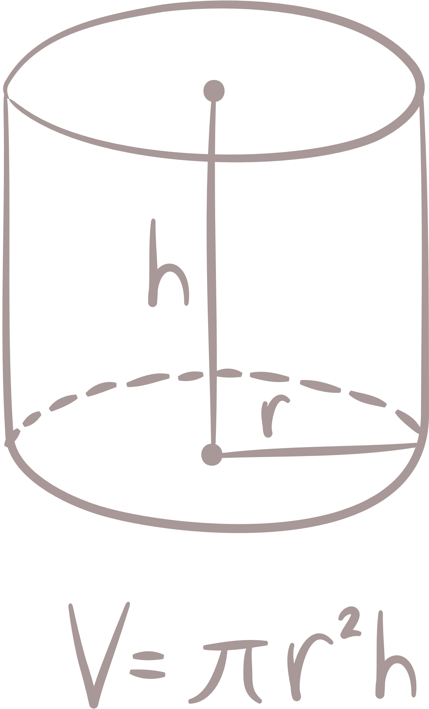
Khmer
Math
for cambodian

Slide 2




contents
What is Khmer Math?
How I build it?
Chanlenges& solutions
What I have learned from this project?
Demo website.

Slide 3

Q1: What khmer math for?
Khmer math is a platform that contain math lesson that Cambodian students can
Learn anytime
and anywhere.

Slide 4









Q2. How I build it?
Result

Slide 5






Q3. Challenges
& solutions
Challenges
Solutions
Complicated
Coding
Ask friends
Using Ai

Slide 6




Q4 What i have learned from
this project?

Slide 7
Q5. dEmo website
https://khmer-math-website-project.vercel.app

Slide 8
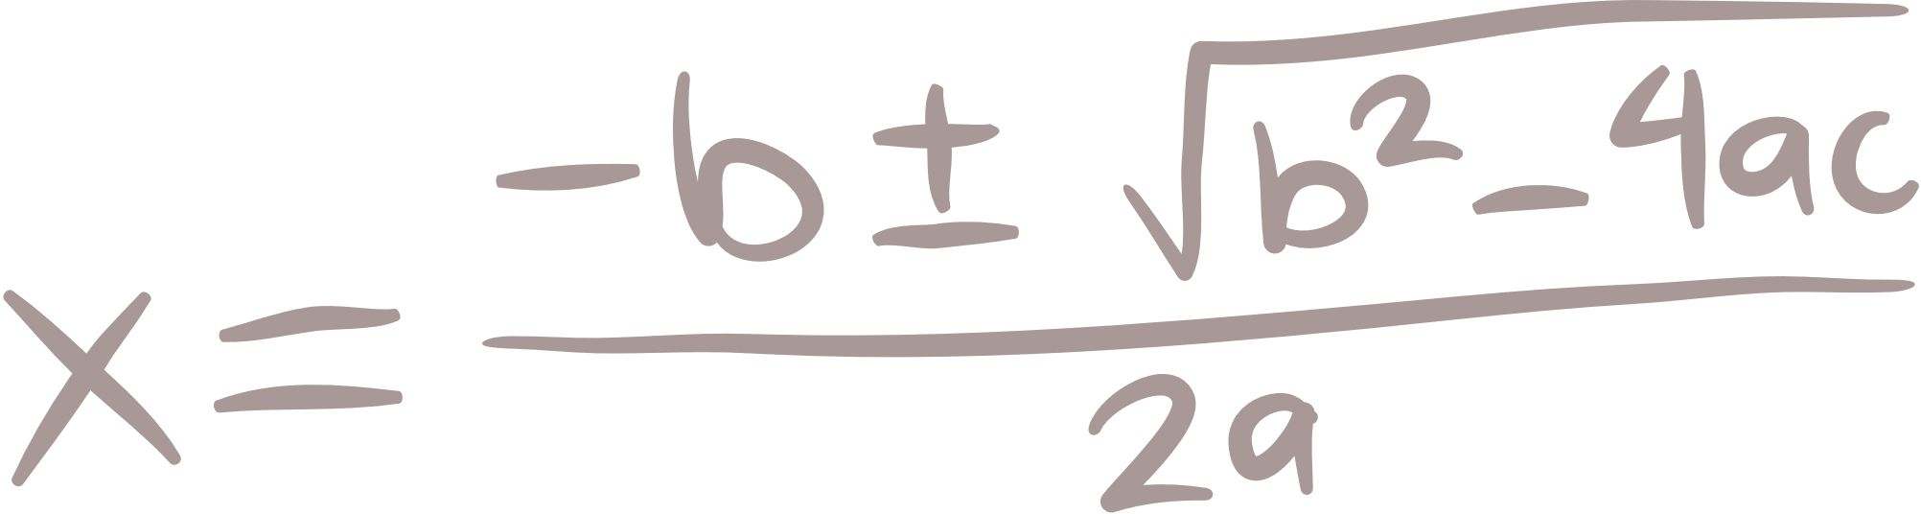
Thank you

